Slide 1
Operators

Slide 2
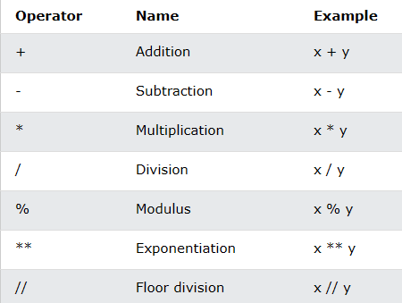
Arithmetic Operators

Slide 3
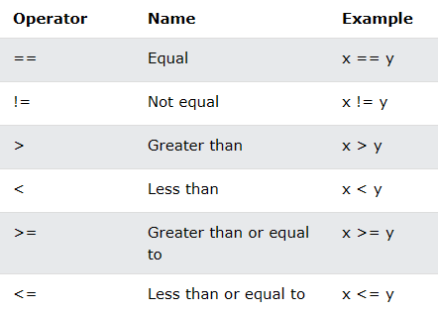
Comparison Operators

Slide 4
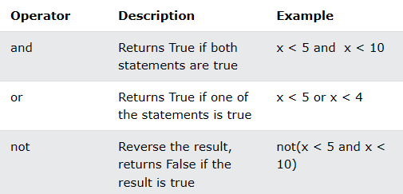
Logical Operators

Slide 5
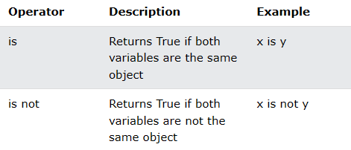
Identity Operators
Identity operators are used to compare the objects, not if they are equal, but if they are actually the same object, with the same memory location:

Slide 6
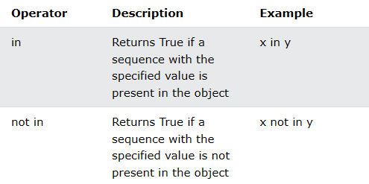
Membership Operators
Membership operators are used to test if a sequence is presented in an object:

Slide 7
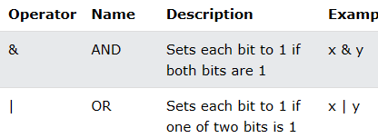
Bitwise Operators

Slide 8
Exercise
What will be the result of the following syntax: x = 5 x += 3 print(x)
3
5
8

